Slide 1
Salary Data Analysis using Excel & SQL
Name : V dhanasekaran
Course : Data analytics and Data science
Batch : april 2025
Date : 22/07/25

Slide 2
OBJECTIVE AND GOALS
Objective :
To Analyze A Comprehensive Global Salary Dataset Using SQL And Excel In Order To Uncover Key Trends And Insights Related To Compensation Across Various Industries, Job Roles, Education Levels, And Experience Bands.
Goal :
Analyze global salary survey data for trends and patterns
Use SQL for structured data querying
Use Excel for visualizing insights with PivotTables and dashboards
Build an interactive dashboard using slicers and charts for exploration

Slide 3
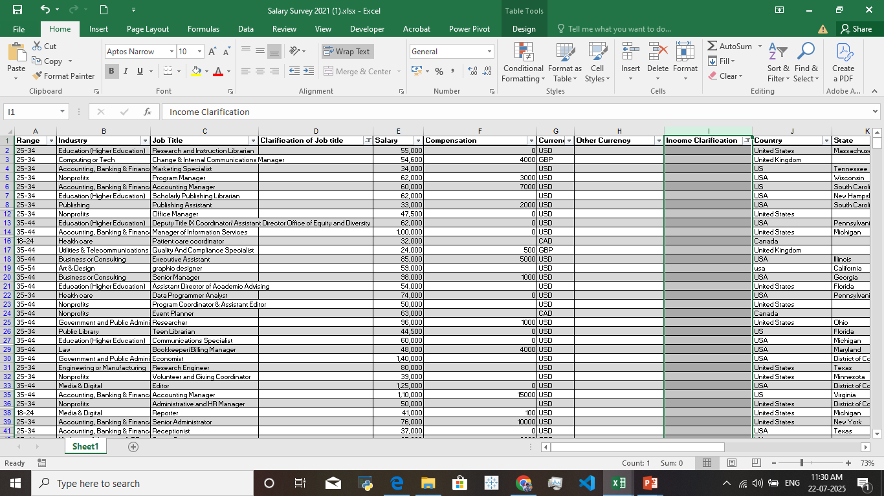
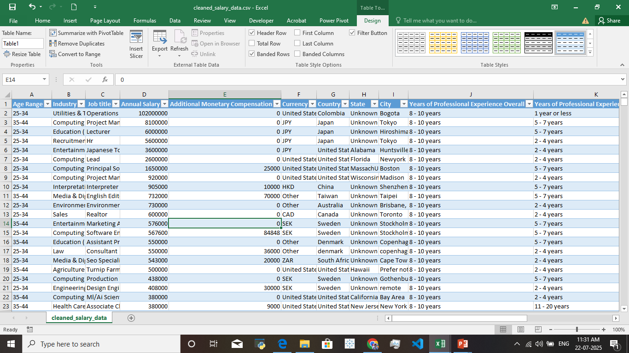
Dataset Overview And Preparation
Dataset Overview :
The Dataset Contains Over 60,000 Global Employee Responses From A 2021 Salary Survey, Including Fields Like Gender, Job Title, Industry, Education, Experience, Salary, And Bonuses.
Data cleaning process :
Imported Raw Dataset into Excel and reviewed all columns
Cleaned Data by removing duplicates, null values, and outliers
Formatted Columns for consistency (e.g., salary, experience)
Raw Data
Cleaned Data

Slide 4
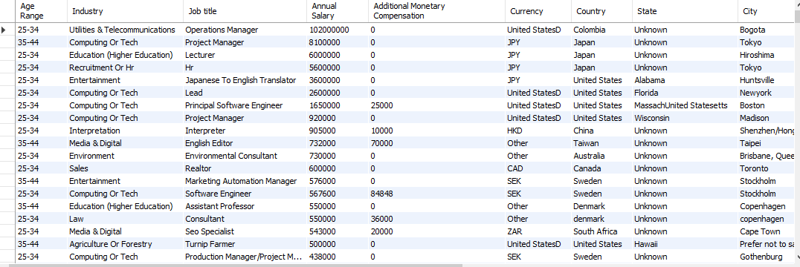
File Importation And Database Creation
File import :
The Cleaned Excel Dataset File Converted And Import Into The SQL Workbench CSV File Format To Perform An SQL Based Queries
Database Creation :
Creating An SQL Database In SQL Workbench Named As Salary_survey_db
After That Create An Table Named As Salary_data

Slide 5
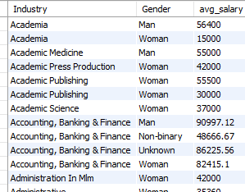

Some SQL Queries Based Analysis
Average Salary By Gender And Industry :
To Identify The Industry And Gender Has A High Salary For Their Profession
Used Queries :
Group Function To Group The Salary Data
Use Avg() Function To Find The Average Salary
Additional Compensation Percent By Gender :
To Identify An Which Gender Has High Additional Compensation
Used Queries :
Group Function To Group The Genderwise
Use Case When() Function To Calculate Percentage

Slide 6
Export SQL Query And Import In Excel
Exportation SQL Query :
After Running SQL Queries And Result To Saved As CSV Files
To Export The CSV Files Perform For The Excel Dataset Creation
Importation Into Excel :
Saved The Workbook As The Master Source For Pivot tables And Dash boarding
Imported Cleaned CSV File Into Excel
Converted Data Into An Excel Table Format For Structured Reference
Used "Add This Data To The Data Model" Option To Enable Unified Slicer Control
Checked Data Types, Cleaned Headers, And Ensured Consistency

Slide 7
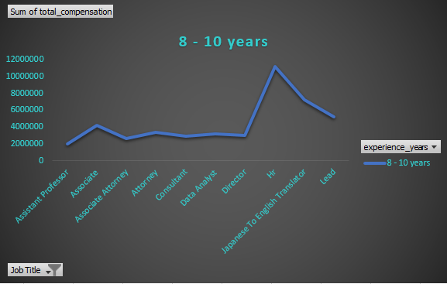
Some Insights From Pivot Charts
Insight-1 Experience By total Compensation :
Chart Type :
Line Chart
Components Used :
Pivot Table Filtered By Job Title
Field: Experience of Years
Slicer: Job Title
Insights :
Human Resources, Tech Leads, and Data Science roles offer the highest total compensation
Entry-level roles like Interns and Support Engineers show lower overall pay
As job title seniority increases, compensation rises significantly
Outliers in "Some College" and "Freelancer" roles hint at variability in job naming or niche roles

Slide 8
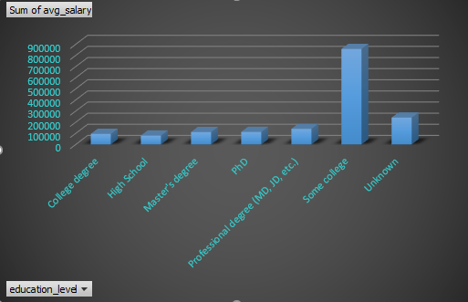
Insight 2 – The Average Salary By Education
Chart Type :
3-D Stocked Column
Components Used :
Pivot Table Filtered By Education Level
Field: Average Annual Salary
Slicer: Gender
Insights :
P.hd And Master's Degree Holders Earn Significantly More
“Some College” Group Showed An Unusual Salary Peak (Possible Outliers)
Clear Salary Growth Trend With Higher Education Level

Slide 9
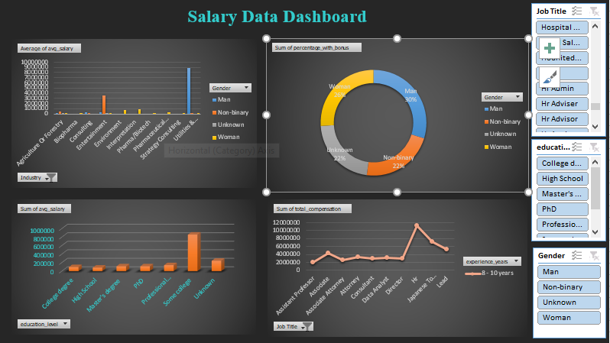
Dashboard Design
Structure & Elements
Created 4 Pivot Charts using cleaned data and SQL outputs
Added Slicers for:
  Gender
  Job Title
  Education Level
Used charts like:
  Clustered Column Chart
  Donut Chart
  3-D Stocked Column Chart
  Line Chart

Slide 10
Conclusion :
SQL Helped Uncover Meaningful Patterns In Salary, Education, And Compensation
Excel Enabled Dynamic Visualization Using Pivot tables And Slicers
Dashboard Offers Interactive Insights For Real-time Decision-making
Salary Trends Vary Significantly By Industry, Education, And Job Title
Recommendations :
Address Gender Pay Gaps In Specific Industries
Focus On Experience-based Compensation Models
Use Data To Standardize Pay Scales Across Regions
Encourage Upskilling To Boost Compensation Potential
Thank you !

